Slide 1
IEEE ACCESS
Intelligent Data Engineering for Migration to NoSQL Based Secure Environments
SHARABA RAMZN, IMRAM SARWAR BARJWA, BUSHRA RAMZAN
AND WAHHED ANWAR
CHANGWON NATIONAL UNIVERSITY

Slide 2
Outline
Abstract
Introduction
Background : RDBs and big data databases
Methodology for proposed approach
Data cleansing module
Results and evaluations
Conclusion and Future works

Slide 3
Abstract
Needs of the larger enterprises to shift NoSQL database from RDB
Proposal two modules :
Data transformation module
Data cleansing module
The study shows :
Successful transformation the RDB to a big data database (Oracle NoSQL)
Improvement of transformed data quality

Slide 4
Outline
Abstract
Introduction
Background : RDBs and big data databases
Methodology for proposed approach
Data cleansing module
Results and evaluations
Conclusion and Future works

Slide 5
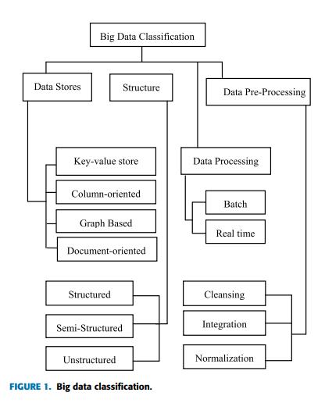
Introduction
Conventional databases - RDBs (Relational Databases)
Structural model and supporting SQL (Structured Query Language)
Unstructured model occurs → Convert into structured data by ETL tools
Big data
3V : Volume, Velocity and Variety
Thousands of client who have a variety of data visit social network
Classification of big data into various categories [Fig 1]
Extract, Transform, Load

Slide 6
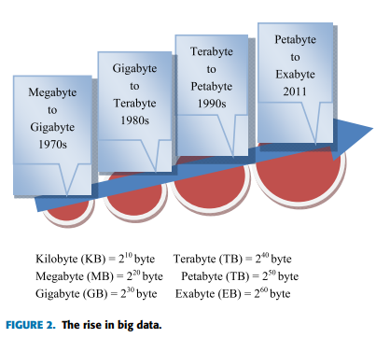
Introduction
Cloud computing
Data stores for handling massive amount of data (Beyond the 1 TB)
Huge amount of data in petabyte range [Fig 2]
Creation an issue in terms of response time

Slide 7
Introduction
A challenge to handle the big data by RDBMS in cloud computing
To overcome the limitation of RDBs
To handle all types of data
Highly flexible
Distributable
Scalable
Lower cost
To scale out on commodity clusters (Horizontal scalability)
To allow the storage of massive amount of data
To lesser maintenance and tuning requirements

Slide 8
Introduction
Storage alternative : Big data database (NoSQL)
Research aims
An automated conversion of existing RDB to NoSQL database
Data cleansing to improve data quality
Test case
RDB : MySQL
NoSQL : Initial version of the Oracle NoSQL

Slide 9
Outline
Abstract
Introduction
Background : RDBs and big data databases
Methodology for proposed approach
Data cleansing module
Results and evaluations
Conclusion and Future works

Slide 10
Background : RDB
Based on the relational model introduced by Edgar Frank Codd in 1969
Entity relationship in tables :
One-to-one
One-to-many
Many-to-many
Many rows, but all the same type and different content in a table
Supporting SQL

Slide 11
Background : Big data databases
Designed with the needs of ‘big data’ in mind
Own query mechanism (No standard language to be compared with SQL)
No interoperability (=interaction) due to lack of standardization
No concept of primary or foreign key
No need of schemas or join operations to access data

Slide 12
Background : Data cleansing
To improve the quality of data by removing :
Inaccurate (=incorrect)
Incomplete
Unreasonable data
Comprising of following steps :
To define and determine error types
To search and identify error instances
To make correct the errors
To documentation error instances and error types
To modify data entry instances and error types

Slide 13
Outline
Abstract
Introduction
Background : RDBs and big data databases
Methodology for proposed approach
Data cleansing module
Results and evaluations
Conclusion and Future works

Slide 14
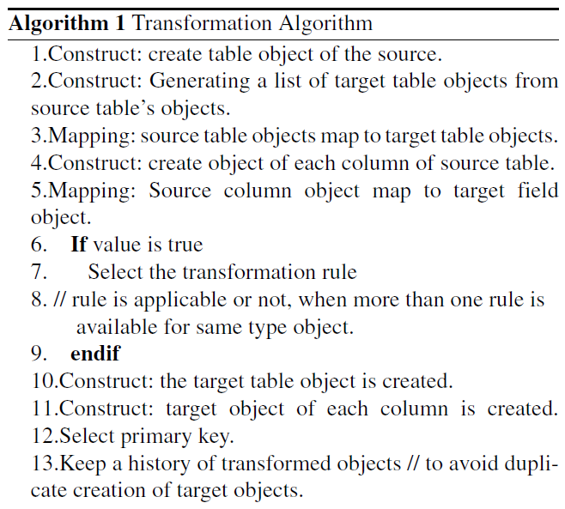
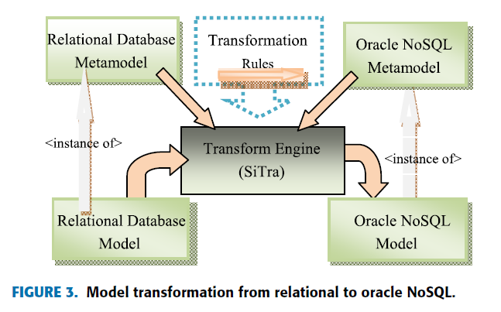
Methodology for proposed approach
Model Transformation
Transformation engine : SiTra
Input model : MySQL
Output model : Oracle NoSQL
Simple Transformer

Slide 15
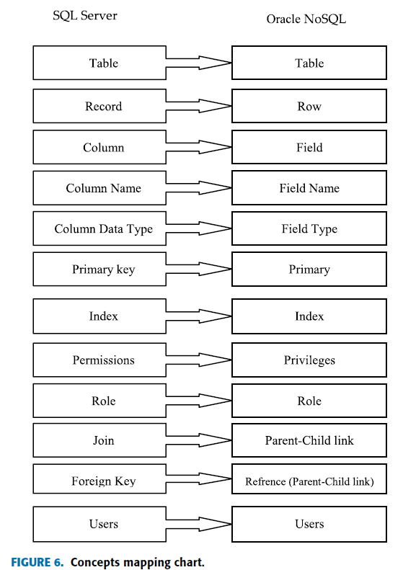
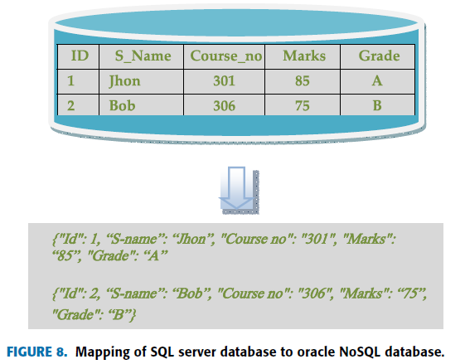
Methodology for proposed approach
Mapping

Slide 16
Outline
Abstract
Introduction
Background : RDBs and big data databases
Methodology for proposed approach
Data cleansing module
Results and evaluations
Conclusion and Future works

Slide 17
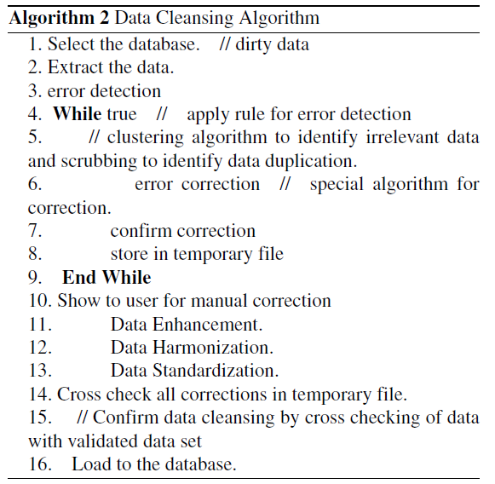
Data cleansing module
To detect and remove data inconsistencies and errors

Slide 18
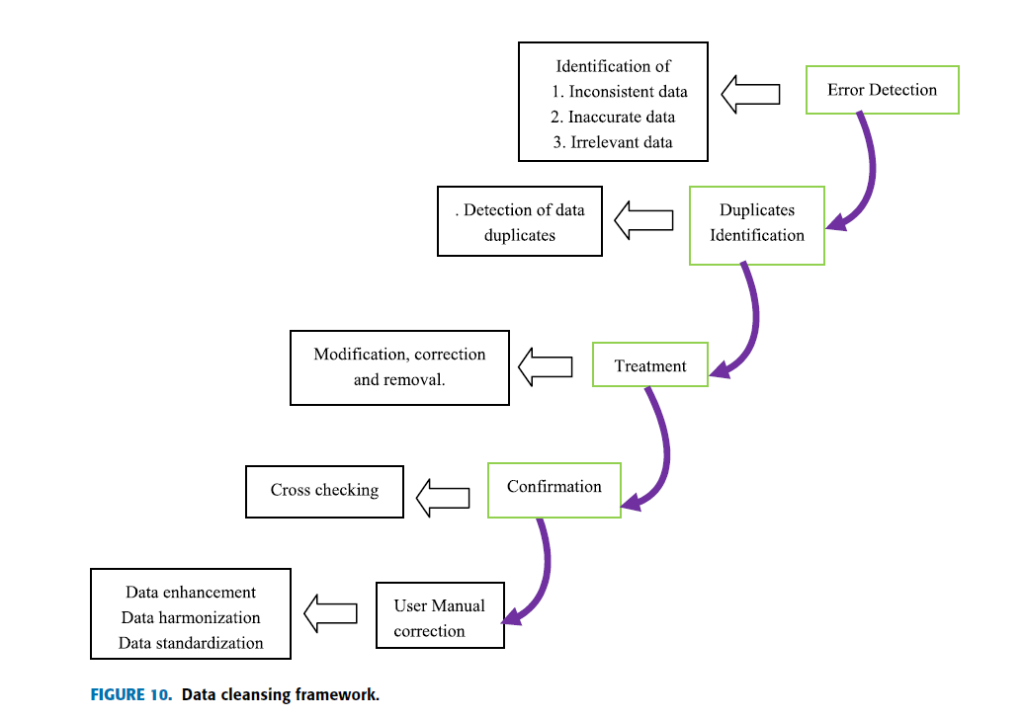
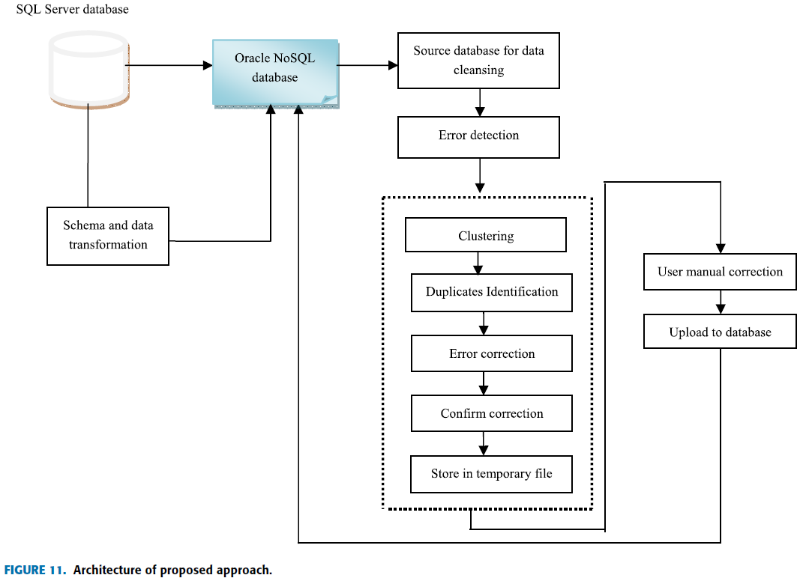
Data cleansing module
Data cleansing framework

Slide 19
Outline
Abstract
Introduction
Background : RDBs and big data databases
Methodology for proposed approach
Data cleansing module
Results and evaluations
Conclusion and Future works

Slide 20



Results and evaluations
Data cleansing evaluation metrics
CP (Correct Positive) : The correct detection of error
IP (Incorrect Positive) : No error but detected as an error
IN (Incorrect Negative) : An error but not detected
Precision : A measure of correctly detected error to all declared errors
Recall : A measure of correctly detected error to all positive detected errors
F-measure : The harmonic mean of Recall and Precision

Slide 21
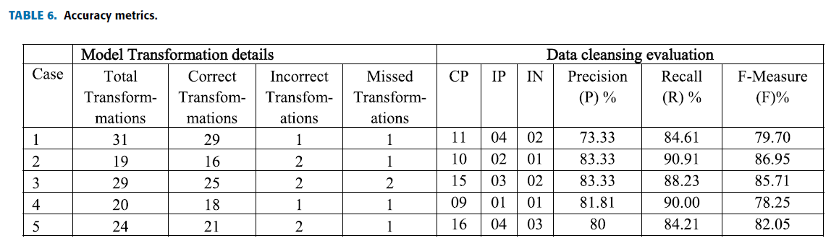
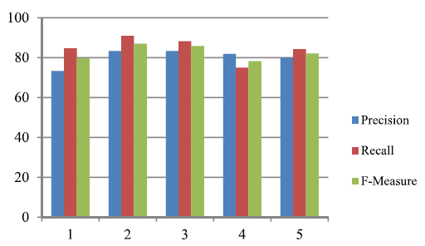
Results and evaluations
Test case
5 Databases from MySQL to Oracle NoSQL

Slide 22
Outline
Abstract
Introduction
Related work
Background : RDBs and big data databases
Methodology for proposed approach
Data cleansing module
Results and evaluations
Conclusion and Future works

Slide 23
Conclusion and Future works
The study proposed shows
Future direction how to approach to shift from RDBs to big data databases
Transformation module via SiTra & what need to prepare
Data cleansing module & how to clean transformed database
Required to enhance data cleansing techniques
Lack of test case
Opinion
Need to describe more example

